Slide 1
Weekly Project Update
Abdellah Sabhi
Laurent Bialylew

Slide 2
Work done this week
01
02
03
Created new UMLs
Added update function
Added new UMLs
Added update function for both authors and books
Added remove function
Added remove function for both authors and books

Slide 3
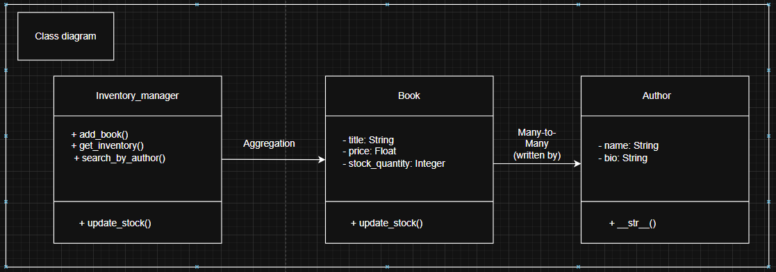
Class UML

Slide 4
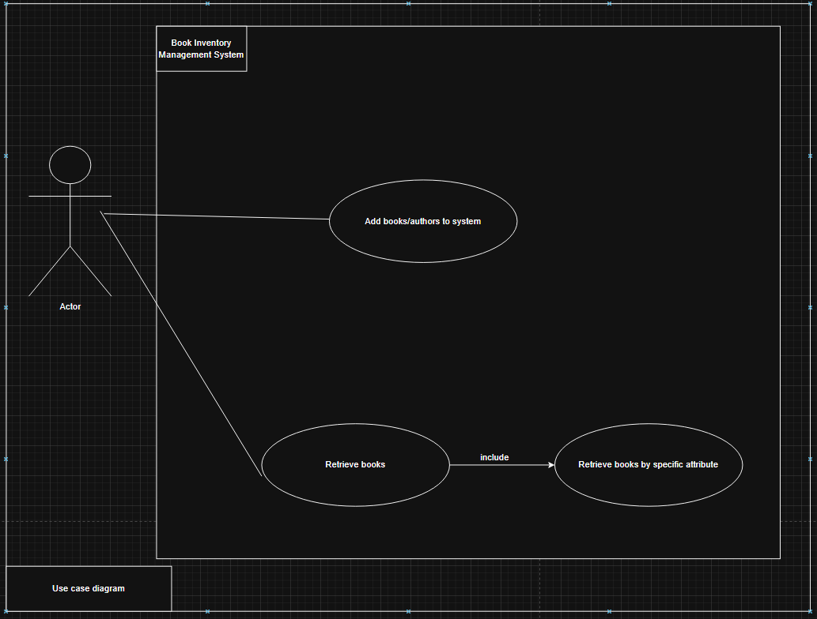
Use case UML

Slide 5
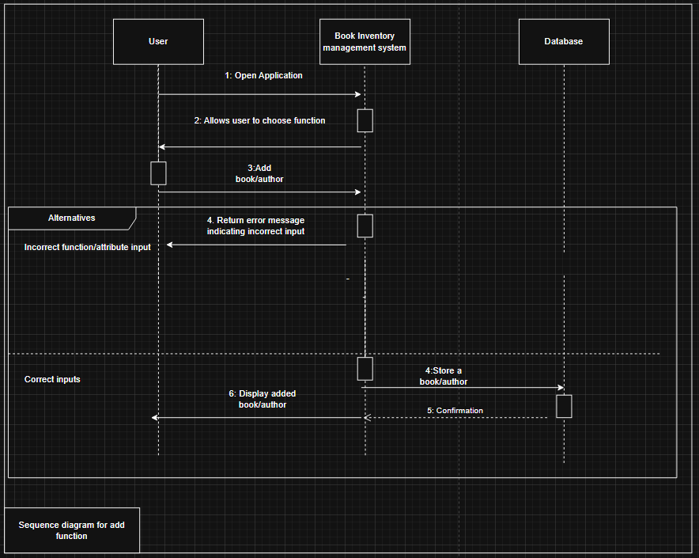
Sequence UML for add function

Slide 6
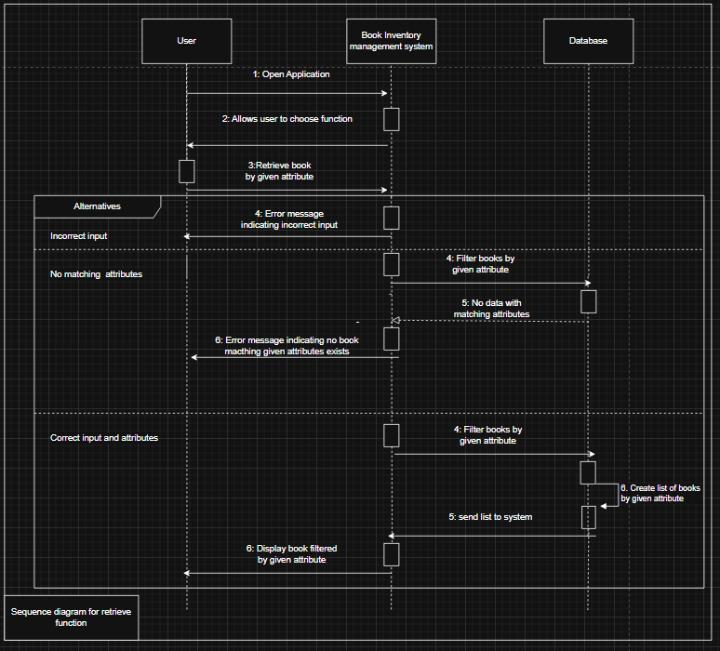
Sequence UML for retrieve function

Slide 7
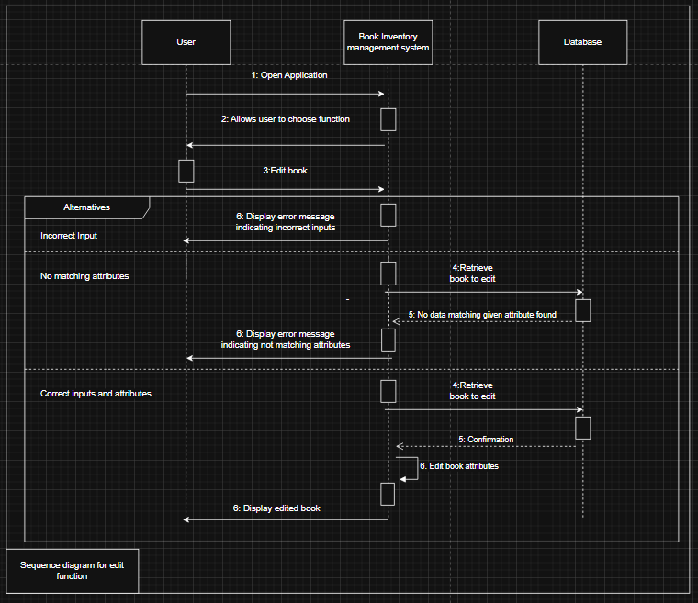
Sequence UML for update function

Slide 8
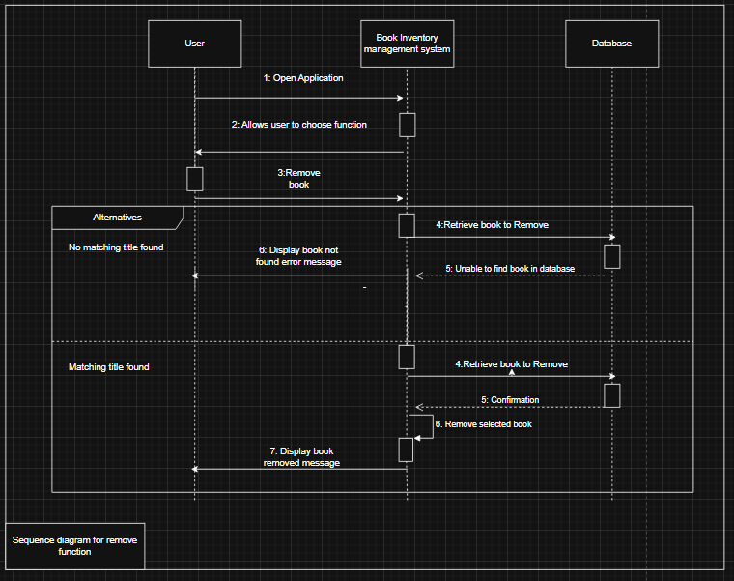
Sequence UML for remove function

